Slide 1
Connected Device Studio Skill Transfer
API Service
Andy Li

Slide 2
Outline
Overview
Traffic Manager
Route
Authentication
OAuth2.0
Implement
Controller
Call Flow
RedisCache
Model
SQLDatabase, IoTDevice, DocumentDB
Model Binding & Vaildation
IOT Device
DocumentDB

Slide 3
Overview

Slide 4
Whole View
Service Bus
3. Log data
7. Submit Task
8. Submit Task
21. Submit Alarm Message
Azure
Storage
Super Admin
Web MVC
Admin
Web MVC
22. Initial / HA / Log
Initial
Redis Cache
20. RT Message
23. Auth
….
2. Data Cache
Admin
API
Device
API
Device
Mgt
24. D2C Message
Azure SQL
1. Entity Framework
25. DM
….
Restful API
27. Alarm Message
5. Log data
6. Image File
26. C2D Message
Azure
Storage
13. Heartbeat
17. D2C Message
IoT Hub
IoT Device
/ GW SDK
SB Client
Alarm Ops
SB Client
Infra Ops
Routine Task
IoT Hub
Receiver
28. Call Ext App.
Backend Process (Service Fabric)
18. C2D Message
19. Device Management
External Applications
9. Consume Task
10. Consume Task
12. Consume Task
15. Create DB
16. Store Message
11. Get Doc Usage.
14. Task Update
Service Bus
Azure SQL
Document
DB

Slide 5





Service Architecture
API Services : geo-redundancy (HK, SG …), and offer single access point by Traffic Manager (DNS)
Serve: Admin Web, SuperAdmin Web and IoT Device
Blob Storage: API service stores image/photo of company, factory, equipment which upload from Admin/Super Admin.
Azure SQL: API service access company, factory, equipment, employee, device and other business entities.
RedisCach: as data cache layer of Azure SQL.
Document DB: API service read telemetry message.
Admin Web
Blob Storage
API Service
HK
Redis Cache
Super Admin
Traffic
Manager
Azure SQL
IoT Device
API Service
SG
Document DB

Slide 6

Design Pattern
Resources
API Service
Client
Share Library
Model
Controller

Slide 7
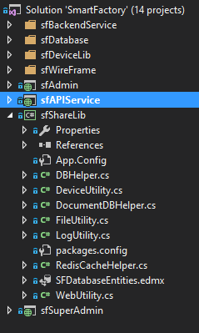
File Structure
Admin Web
Blob Storage
API Service
HK
Redis Cache
Super Admin
Traffic
Manager
Azure SQL
IoT Device
API Service
SG
Document DB

Slide 8
Traffic Manager

Slide 9
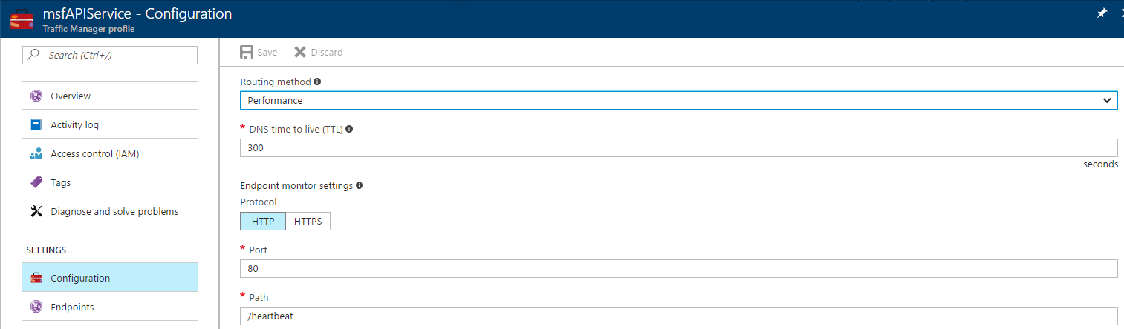
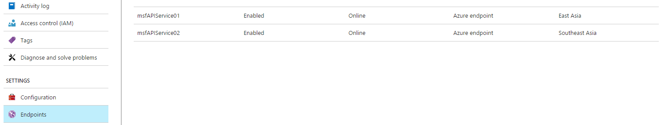
Traffic Manager
API File Path : sfAPIService/Controllers/RefCultureInfoController.cs
Notes:
Performance : lowest network latency

Slide 10
Route

Slide 11
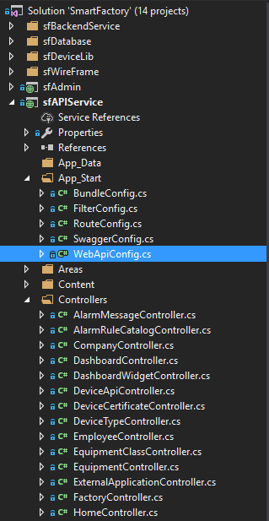
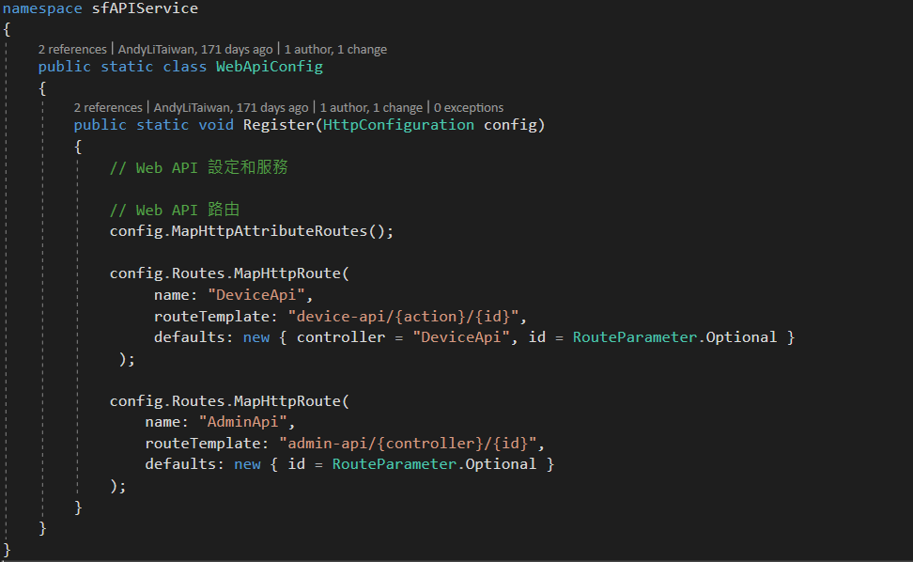
Two Path – BaseUri/device-api/~
For Connected Device Studio Device SDK
Notes:
給誰用 用意
Device api 交代清出點 分兩夜
註解

Slide 12
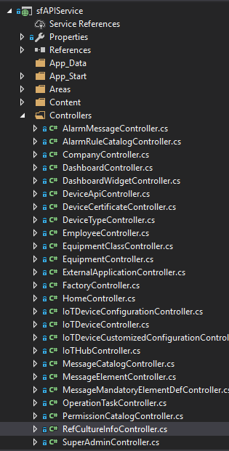
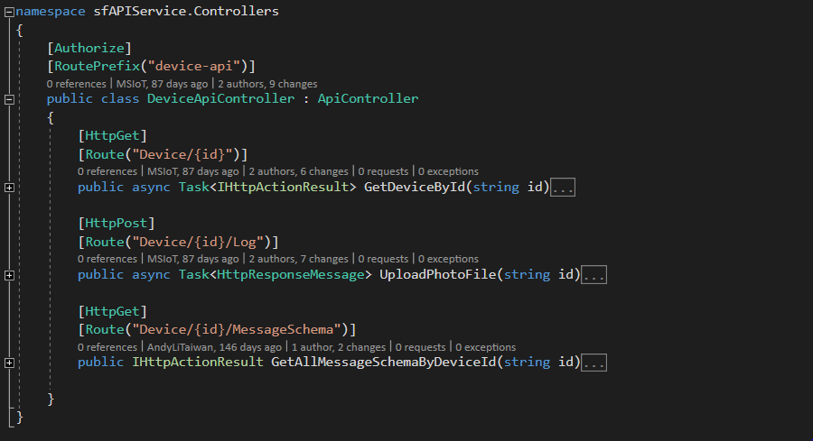
Example – BaseUri/device-api/~
device-api/{id}
device-api/{id}/Log
device-api/{id}/MessageSchema

Slide 13
Two Path – BaseUri/admin-api/~
For web service : both of Admin and SuperAdmin
Notes:
給誰用 用意
Device api 交代清出點 分兩夜
註解

Slide 14
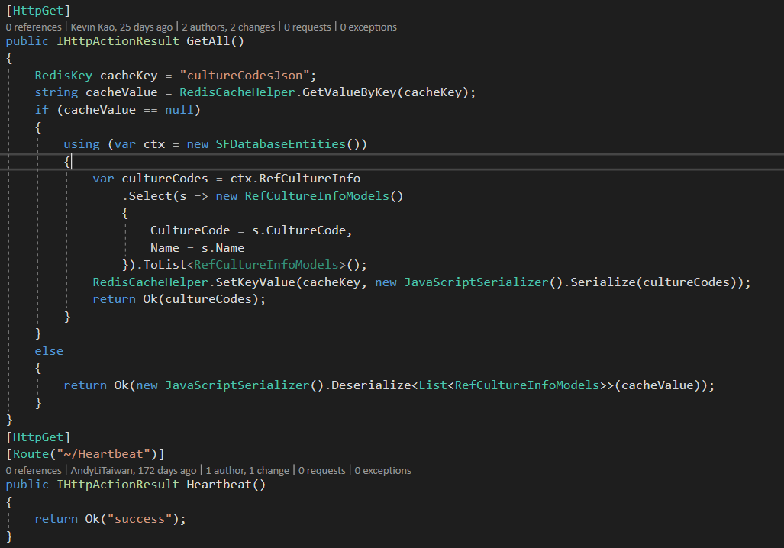
Example – BaseUri/admin-api/~
admin-api/RefCultureInfo
admin-api/Heartbeat

Slide 15
Authentication
Notes:
Why need use
每次使用帳密會有安全性問題

Slide 16
OAuth 2.0 - Resource Owner Password Credentials Grant
Client
Resource Owner
Resource Owner Password Credentials
Resource Owner Password Credentials
Authorization
Server
Access Token (Bearer Token)
Access Token (Bearer Token)
Resource
Server
Protected Resource

Slide 17
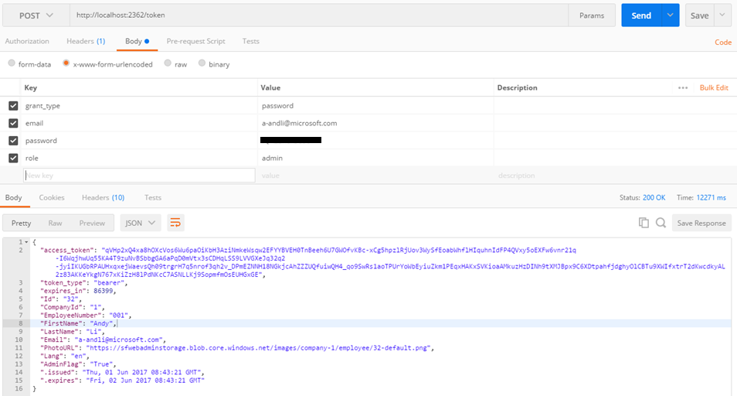
OAuth 2.0 – Get Token
URL : basrURI/token
Role : Admin, SuperAdmin, Device

Slide 18
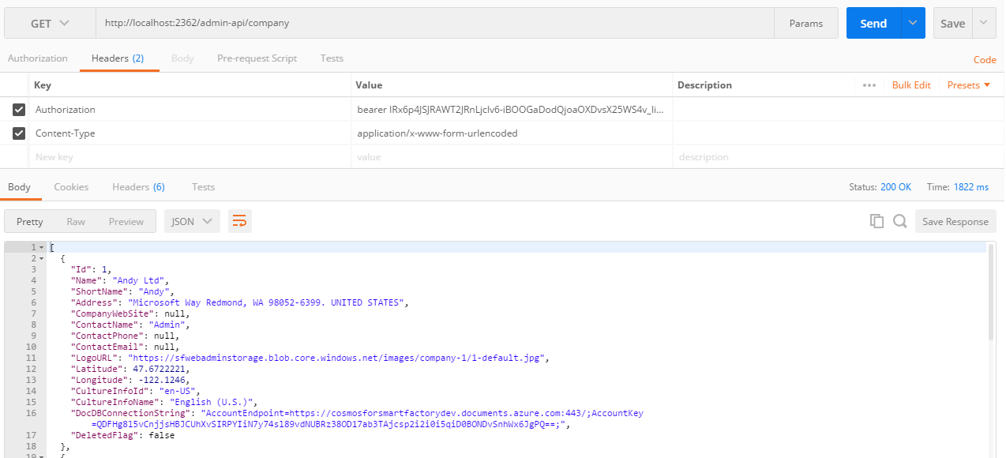
OAuth 2.0 – Get Protected Resource
Authorization : “bearer” + token

Slide 19
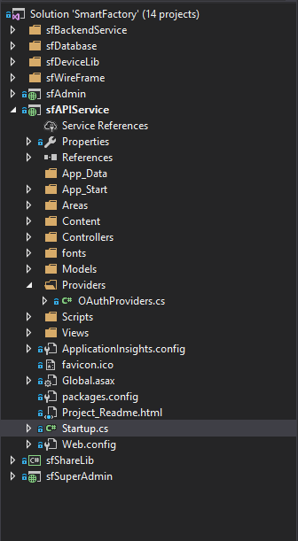
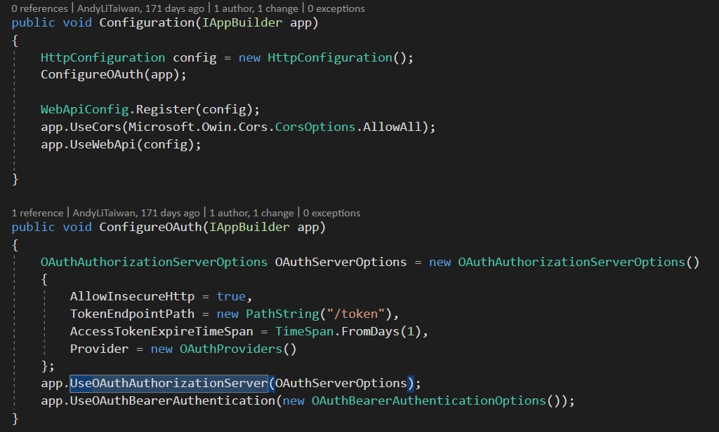
Implement – Authorization Server
Notes:
Token expire

Slide 20
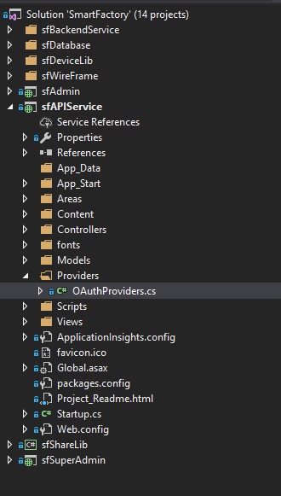
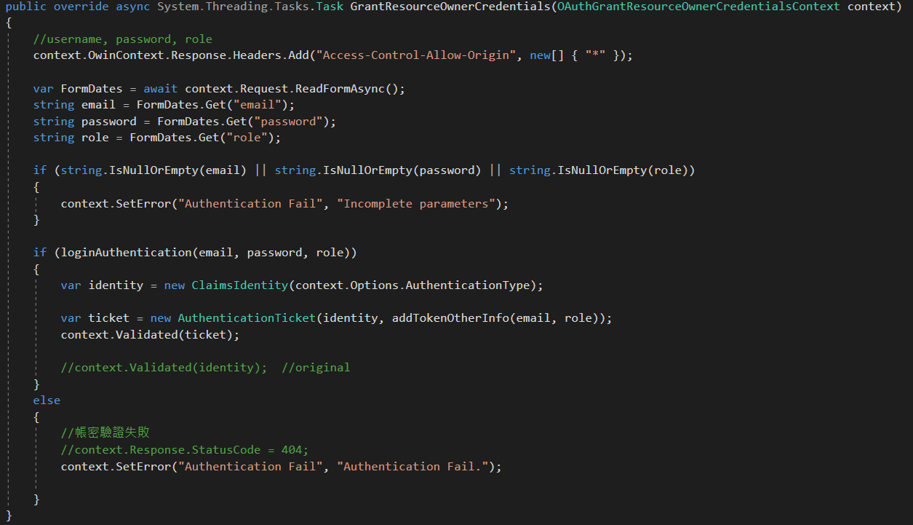
Implement – Authorization Server

Slide 21
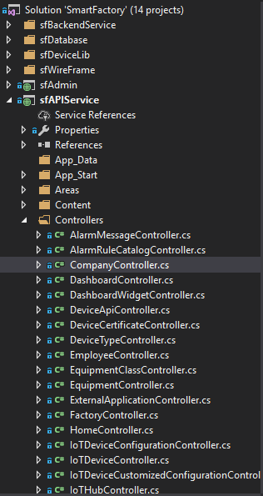
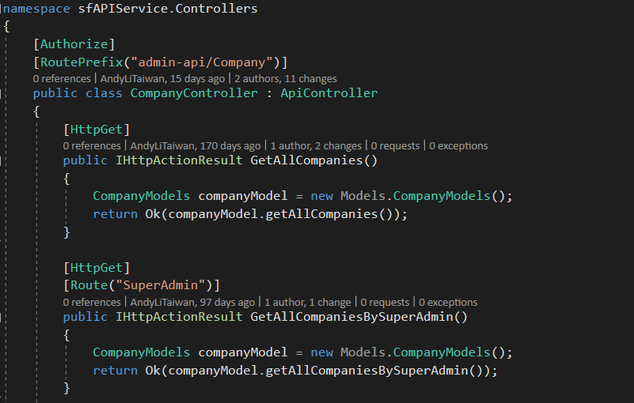
Implement – Resource Server

Slide 22
Controller

Slide 23
Controller
Swagger
Return data
Record log
Upload Image
Edit RedisCache
Notes:
http://api.iot-smartfactory.net/swagger/ui/index
Heartbeat, RefCultureInfo

Slide 24

Call Flow - [POST] admin-api/Employee
Insert employee data
Return employee Id
1
4
Exception
[POST] admin-api/Employee
Return employee Id
Controller
Employee
Company
IoTDevice
IoTHub
…
2
3
Models
Others(Employee)
DocDB_AlarmMessage.cs
Device.cs
Share Library
DocumentDB
Helper
DB
Helper
RedisCache
Helper
Device
Utility
File
Utility
Log
Utility
Entity Framework (sfShareLib / SFDatabaseEntities.edmx)
Document DB
SQL Database
Redis Cache
IoT Hub
Azure Storage
(Container: log-apiservice)

Slide 25
RedisCache
Implement in sfShareLib/RedisCacheHelper.cs
Apply to controller
Design Pattern
[POST] : do nothing
[PUT] : purge employee cache
[GET] : create employee cache
[DELETE] : purge employee cache
Employee
Cache Key : “employee_” + id
“employee_” + id + “_role”
“employee_” + id + “_permission”
Basic Information
Role
Permission
Notes:
Purge employee cache
Create employee cache
Cache Key

Slide 26
Call Flow – [PUT] admin-api/Company/{Id}/Image
Upload image
Update company photo URL
Delete employee Cache
1
Exception
[PUT] admin-api/Company/{Id}/Image
Controller
Company
Employee
IoTDevice
IoTHub
…
3
4
2
Models
Others(company)
DocDB_AlarmMessage.cs
Device.cs
Share Library
DocumentDB
Helper
DB
Helper
RedisCache
Helper
Device
Utility
File
Utility
Log
Utility
Entity Framework (sfShareLib / SFDatabaseEntities.edmx)
Container: log-apiservice
Container: images
Document DB
SQL Database
Redis Cache
IoT Hub
Azure Storage

Slide 27
Call Flow – [GET] admin-api/Employee/{Id}
Get data from RedisCache
Get data from SQL Database
Insert data to RedisCache
1
[GET] admin-api/Employee/{Id}
7
Exception
Return data
Controller
Employee
Company
IoTDevice
IoTHub
…
2
6
Models
Others(Employee)
DocDB_AlarmMessage.cs
Device.cs
4
5
3
Share Library
DocumentDB
Helper
DB
Helper
RedisCache
Helper
Device
Utility
File
Utility
Log
Utility
Entity Framework (sfShareLib / SFDatabaseEntities.edmx)
Document DB
SQL Database
Redis Cache
IoT Hub
Azure Storage
(Container: log-apiservice)

Slide 28
Model

Slide 29
Model – SQLDatabase
DocDB_AlarmMessage.cs
Device.cs
Others
Models
Share Library
DocumentDB
Helper
DB
Helper
RedisCache
Helper
Device
Utility
File
Utility
Log
Utility
Entity Framework (sfShareLib/SFDatabaseEntities.edmx)
Document DB
SQL Database
Redis Cache
IoT Hub
Azure Storage

Slide 30
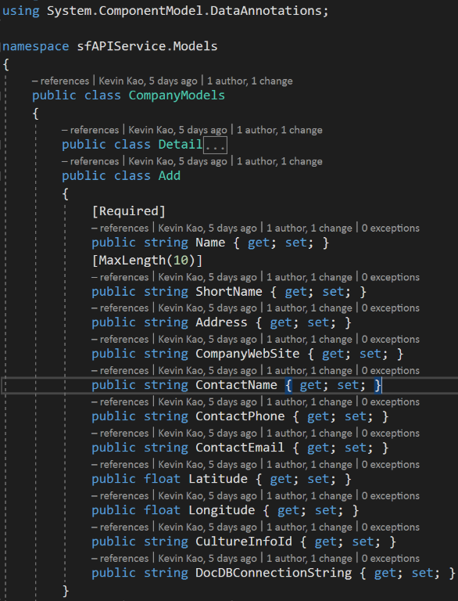
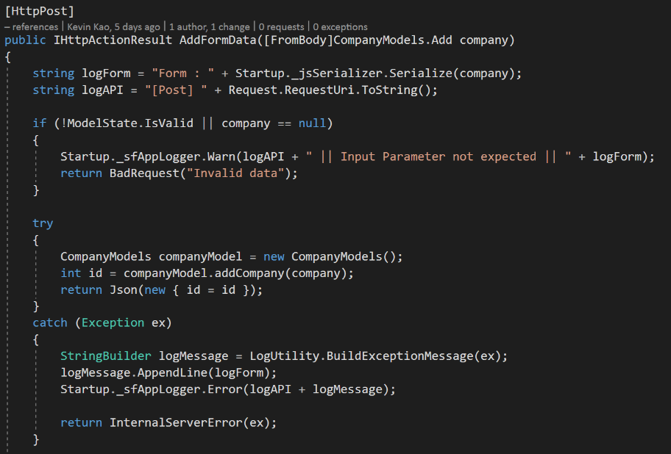
Model – Model Binding & Validation
Models
Controllers
Models/Compnay.cs
Controllers/CompnayController.cs
Notes:
Why to use
Form data 轉 model
Reduce duplicate work

Slide 31
Model – IoT Device
DocDB_AlarmMessage.cs
Device.cs
Others
Models
Share Library
DocumentDB
Helper
DB
Helper
RedisCache
Helper
Device
Utility
File
Utility
Log
Utility
Entity Framework (sfShareLib/SFDatabaseEntities.edmx)
Verify the device is existing
Document DB
SQL Database
Redis Cache
IoT Hub
Azure Storage
Notes:
重要的endpoint列出來
你現在有哪些功能
Swagger go through

Slide 32
Model – Document DB
Now
Future
DocDB_AlarmMessage.cs
Device.cs
Others
Models
Share Library
DocumentDB
Helper
DB
Helper
RedisCache
Helper
Device
Utility
File
Utility
Log
Utility
Entity Framework (sfShareLib/SFDatabaseEntities.edmx)
Document DB
SQL Database
Redis Cache
IoT Hub
Azure Storage

Slide 33
Entity Framework
Notes:
ORM
Reduce dependency with database

Slide 34
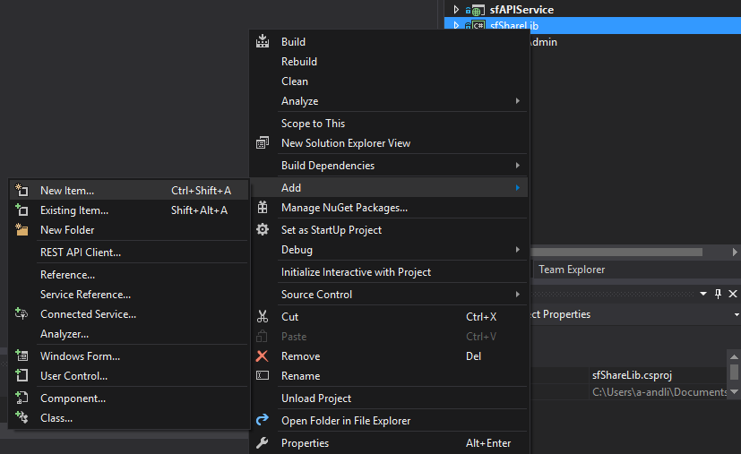
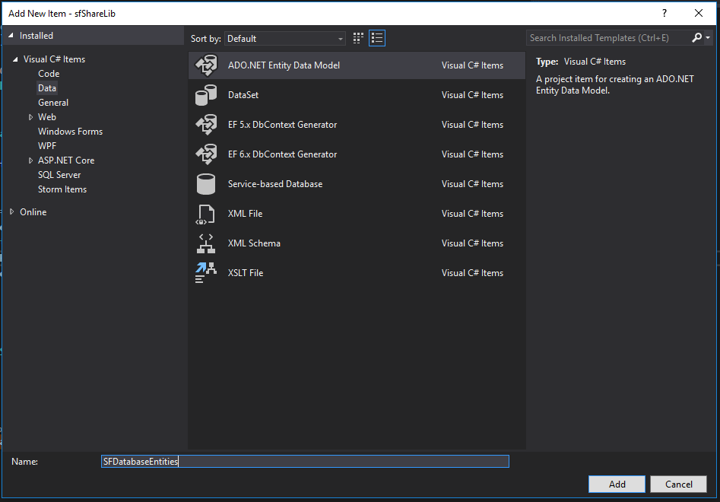
Entity Framework – How to refresh
Delete existing data model(SFDatabaseEntities.edmx) in SfShareLib
Add ADO.NET Entity Data Model into SfShareLib
Name : SFDatabaseEntities

Slide 35
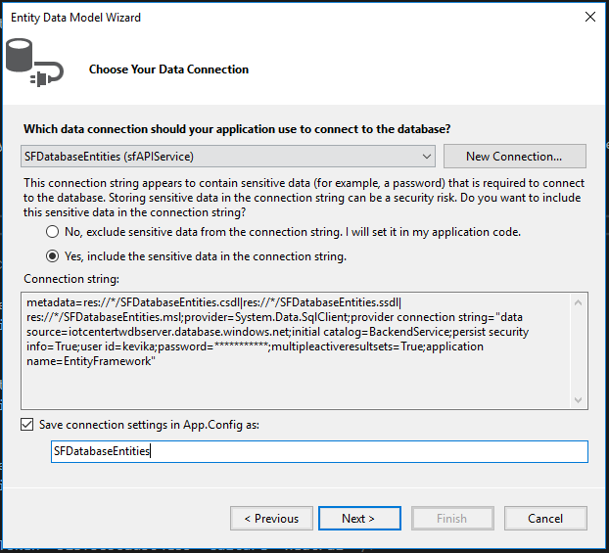
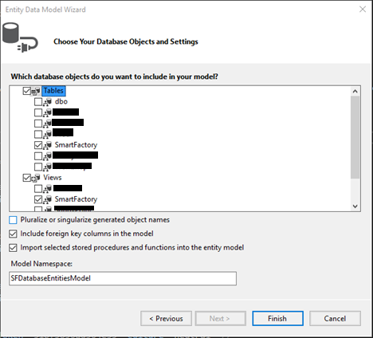
Entity Framework – How to refresh
Choose EF Designer from database
4. Fill in database connection information
5. Model NameSpace : SFDatabaseEntitiesModel

Slide 37
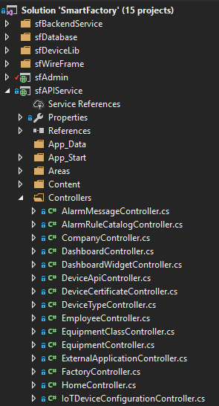
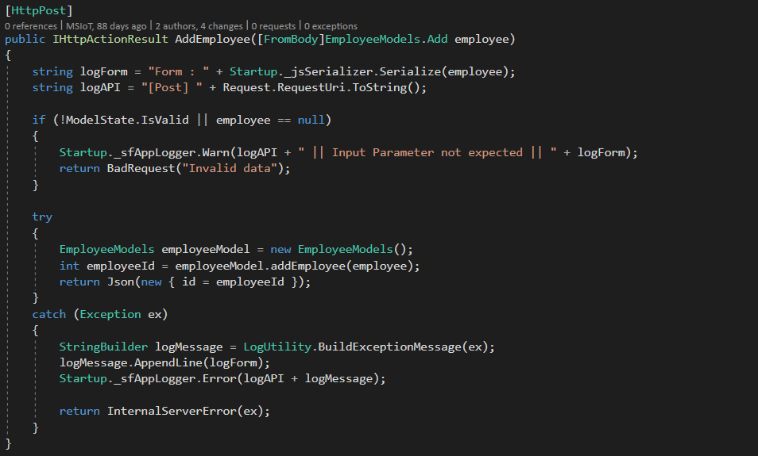
Controller – example(1)

Slide 38
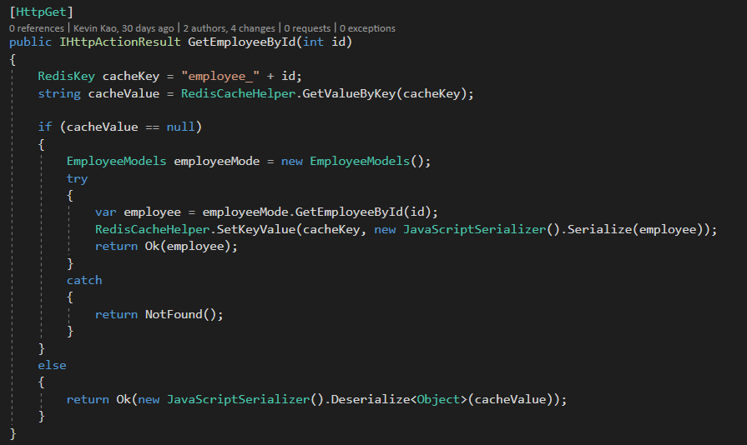
Controller – example(3)

Slide 39
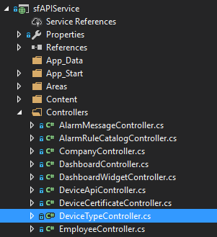
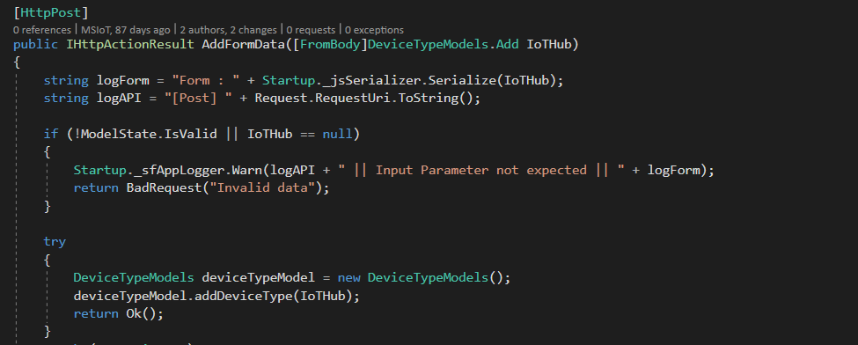
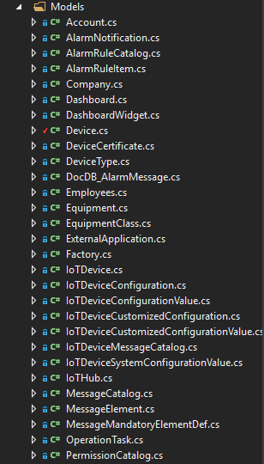
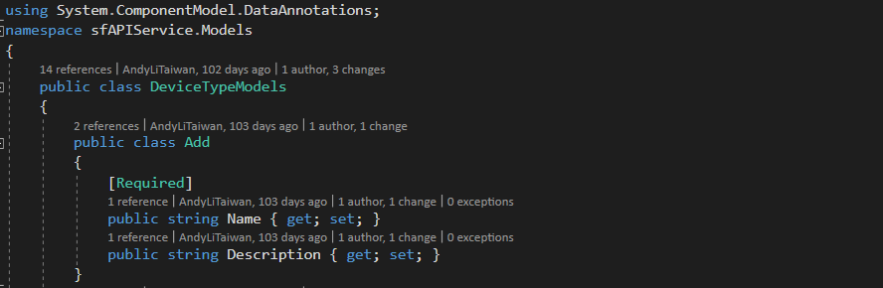
Model – Model Binding & Validation
Controller
Models

Slide 40
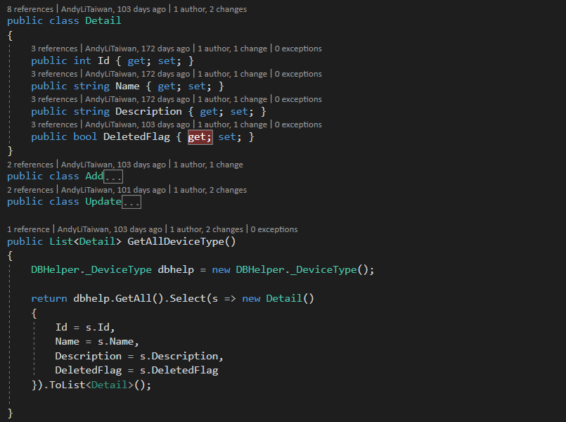
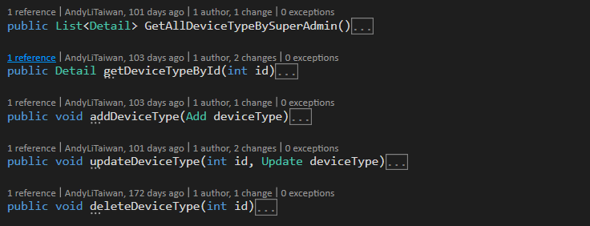
Model – SQLDatabase (example)
Notes:
Sub class parent class

Slide 41
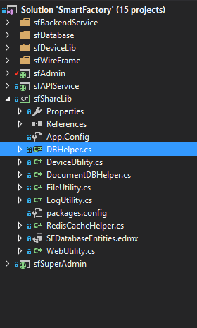
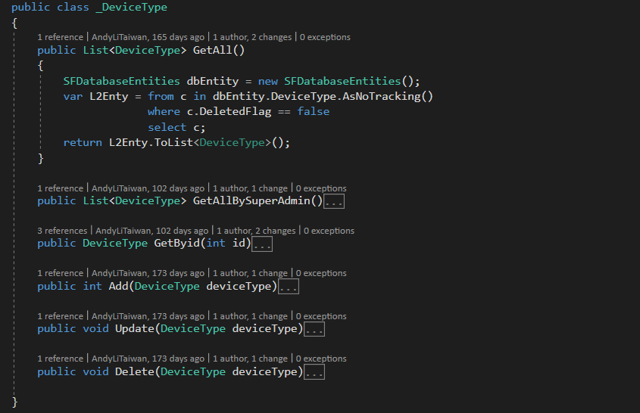
Model – SQLDatabase (DBHelper.cs)

Slide 42
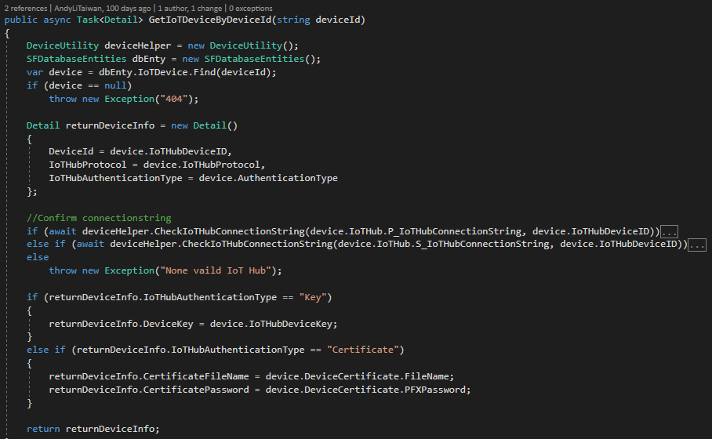

Model – IoT Device (example)

Slide 43
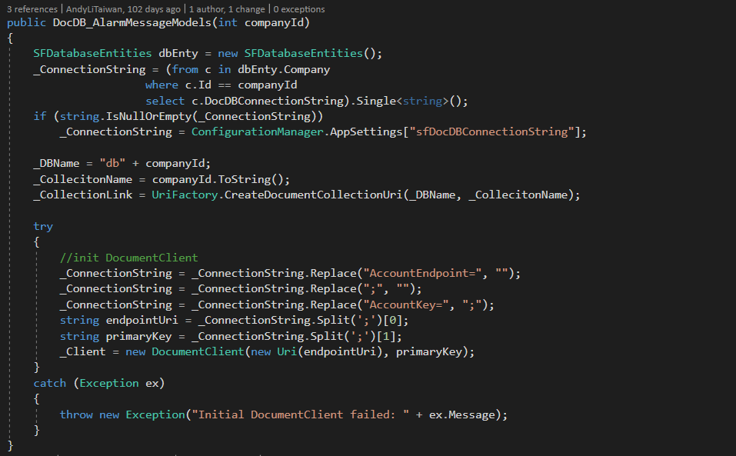
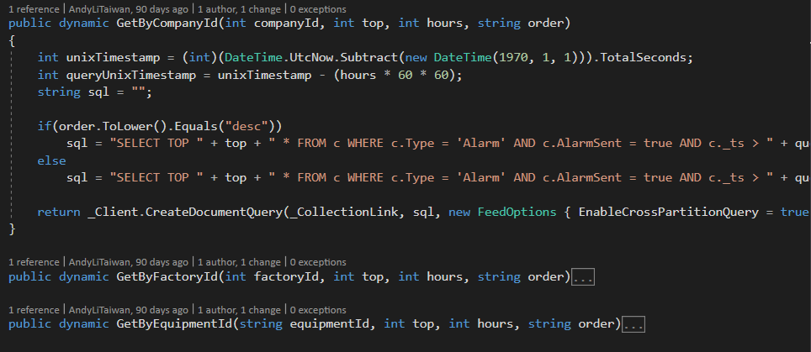
Model – DocumentDB (example)

